Slide 1
Covid-19 viz via cartograms
Johny Rufus

Slide 2
Motivation

Slide 3
Motivation
The impact of COVID-19 also known as the coronavirus, on the life of the people and the economy of the nations has been extremely severe
It is important to study a number of factors related to the disease including but not limited to the spread of the disease, the causal factors, the impact on the economy and a multitude of factors related to how the pandemic is handled and data visualization is an important tool in analyzing the various aspects
Our goal in this project is to create visualizations to better understand the timeline of the coronavirus spread.
In particular, we would like to focus our efforts on utilizing cartograms to create visualizations and time lapse videos to better understand the spread of the disease in the United States.

Slide 4
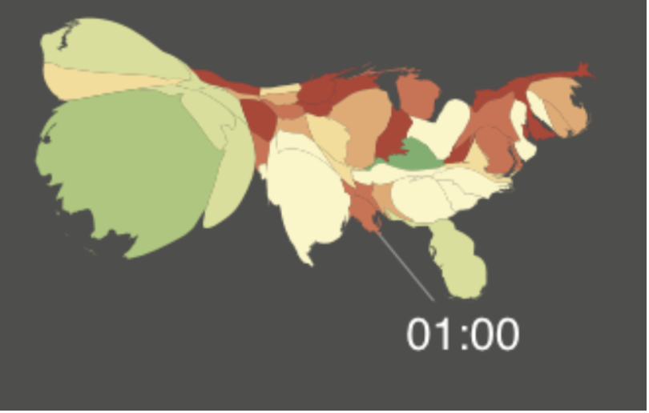
Motivation
Cartograms have proven to be effective tools in visualizing geo referenced data and are very good at highlighting the variable being mapped by modifying the size of the area relative to the variable of interest
Using cartograms has resulted in beautiful visualizations that project the variable of interest in a sharp and outstanding manner as illustrated in the Twitter mood visualization project from our Professor and his team.
Their work captures the changing mood of the people during various times of the day using the sentiment of the tweets. By using cartograms, they are able to efficiently project the size of the states proportionate to the number of tweets, with the color representing the sentiment of the tweets.

Slide 5
Motivation 2012 US Presidential election results: The importance of cartograms in effectively displaying the variable of interest can be very clearly understood from the work done by Newman and Gastner in their work on displaying the 2012 US Presidential election results.
If we look at the normal map to the left and ask you a question as to which party won the election, the answer would be red, as red is more prevalent than blue.
But we all know the democrats won. So why is this discrepancy in the visualization.
Well, the map displays the states using land area and acreage, but the election results depend on the number of electoral votes.
Using cartograms, we can redraw the map, where the size of the state is proportional to the number of electoral votes and that’s the viz on the right, and now if I ask the same question, the answer would be a clear blue thats the beauty and effectiveness of cartograms

Slide 6
Motivation
Taking inspiration from the previously mentioned works, this is what we would like to do.
To begin with, we would first like to visualize the data relating to the confirmed cases and deaths in the US using choropleth maps
Cartograms themselves come in multiple favors and our goal is to experiment with them to find a suitable candidate for the time lapsed video, by first using noncontiguous cartograms and finally moving on to diffusion based contiguous cartograms
To summarize, by using different candidate methods like contiguous and noncontiguous cartograms and choropleth maps, our goal is to create visualizations and time lapsed videos that uniquely visualizes the spread of the coronavirus in the United States over the period of its first case to date.

Slide 7
Existing Work

Slide 8
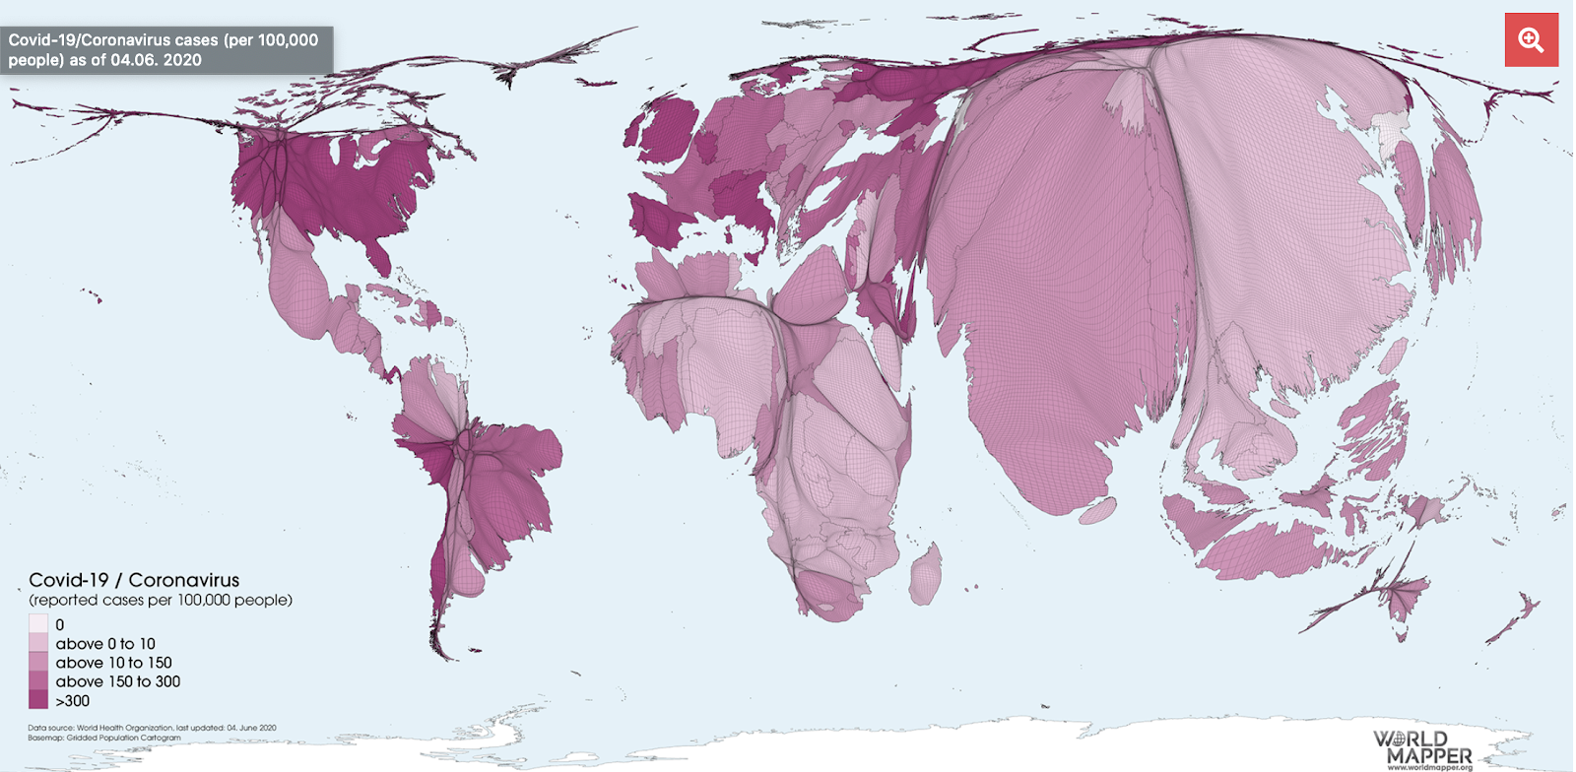
Existing Work
The following is a cartogram visualization of the Covid-19 cases from the worldmapper site.
This cartogram resizes the size of a country in proportion to its population and the color scheme represents the number of reported cases per 100k people.

Slide 9
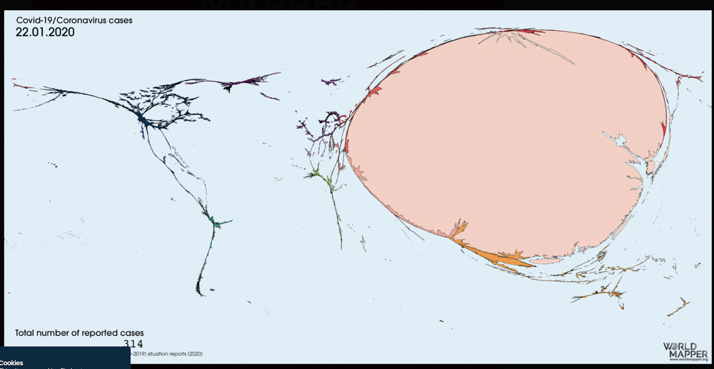
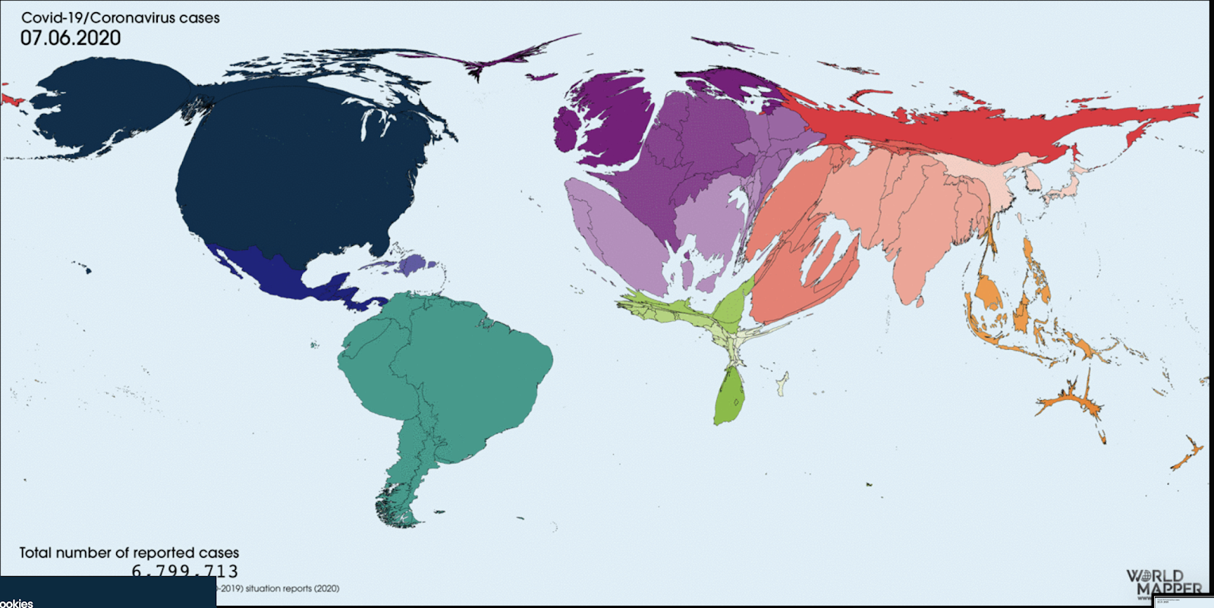
Existing Work
Another nice animation of a time lapse video of the cartogram for the entire world is shown in the worldmapper page.
The cartograms in this visualization resize the area of a region based on the number of cases and the beauty of this visualization is it clearly depicts the flow of the infection, as it starts with January where the entire world is just China as the infection starts and slowly we can see other countries increasing in size.

Slide 10
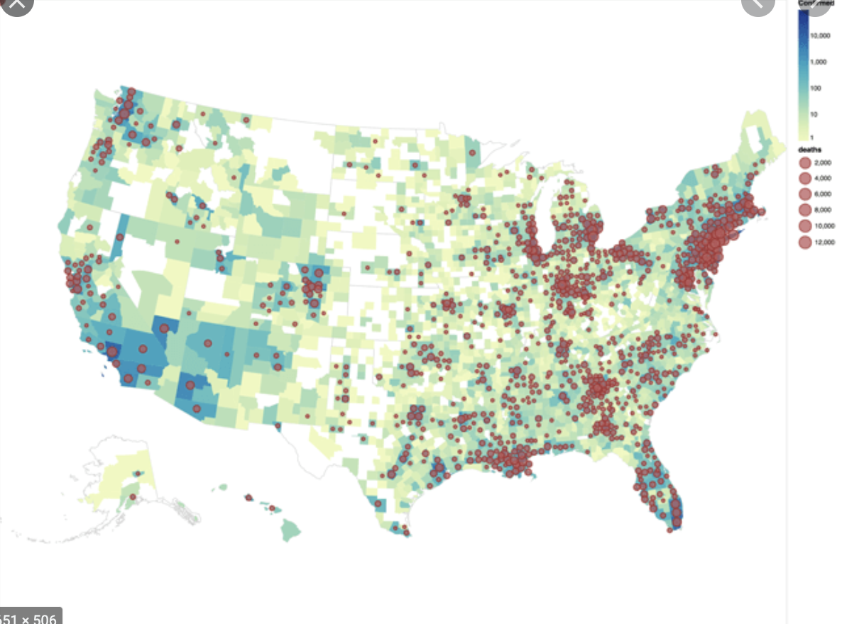
Existing Work
A more popular way of representing the geodata of the covid-19 cases, is by using a choropleth map as shown by this visualization
The choropleth heatmap is very intuitive compared to the cartogram, as it does not distort the geographical shape or size of the regions, but uses heatmap with colors to show the severity of the affected regions.

Slide 11
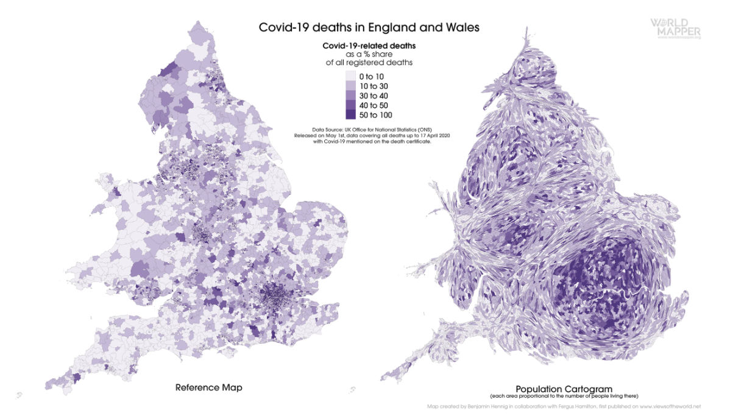
Existing Work
The work done by the viewsoftheworld webpage tries to strike a balance between the cartogram approach and the choropleth approach by drawing them side by side to produce the combined effect as shown.

Slide 12
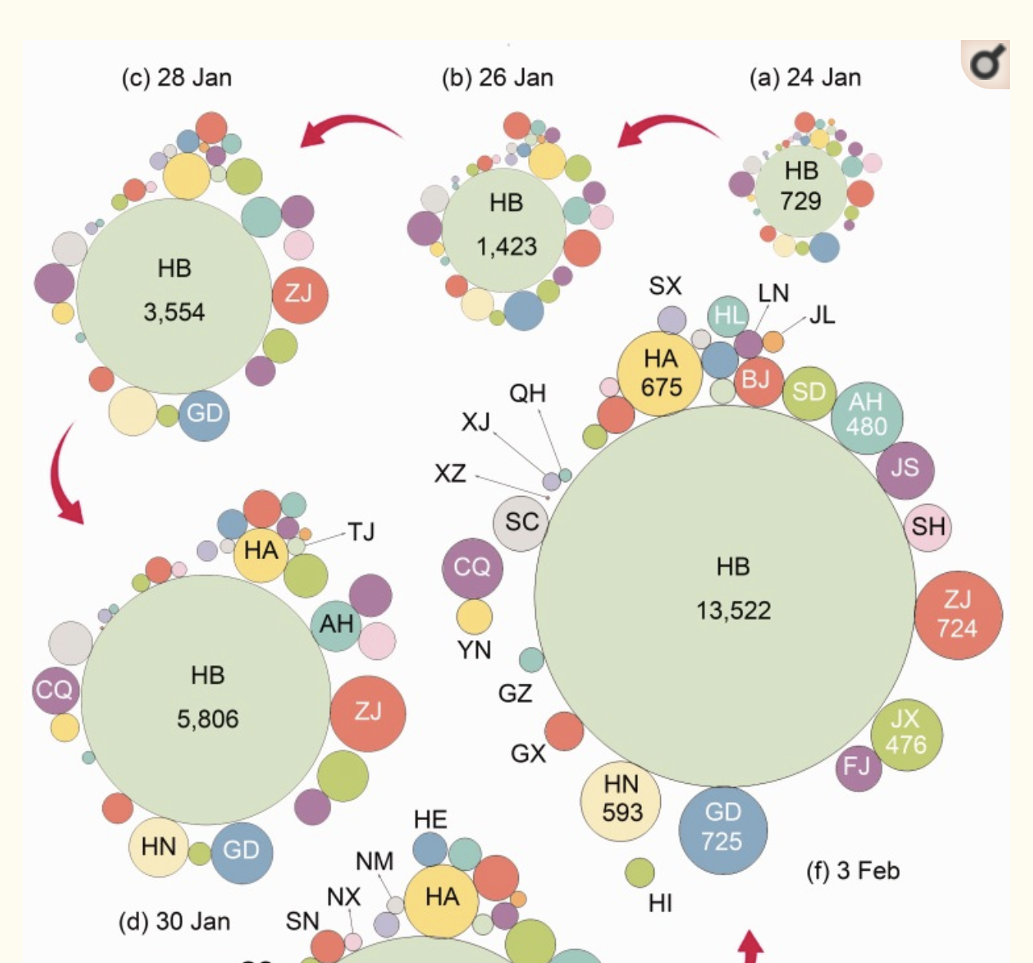
Existing Work
Another interesting work on visualizing covid data using cartograms is by using dorling cartogram to display the data effectively.
This visualization is very effective in portraying the changes in the number of confirmed cases over a time period but suffers from the drawback that it sacrifices the geographical shape of the regions thereby not a very good representation of the underlying geographical region.

Slide 13
Contribution

Slide 14
Contribution
The existing covid-19 visualizations using cartograms represent the data for the entire world and the size of the regions represent the population, and uses colors to represent either the current cases or the deaths.
Our goal is to create a time lapse video of the cartograms for the US region, where both the number of cases and deaths can be unambiguously represented by using the number of cases to resize the size of each state and using sequential colors to represent the death rate. The result is a completely new visualization of the covid-19 pandemic in the US using cartograms effectively displaying both the number of cases and deaths in a completely new and improved set of animations.
In addition to the cartograms and the time lapse video of the US, we have also contributed to the underlying cartogram open source repository (From the original authors of 2004 diffusion based cartogram paper Michael Gastner and Newman) with a couple of fixes and features as well.

Slide 15
Data

Slide 16
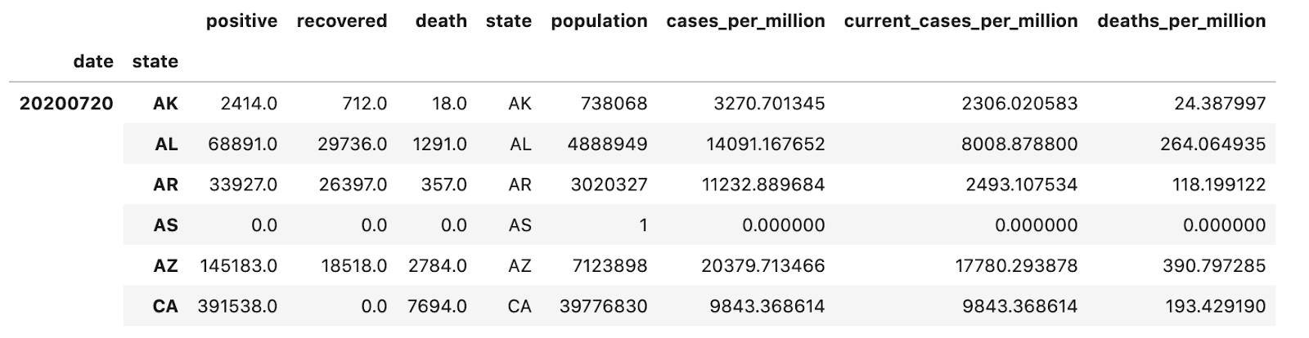
The main dataset to visualize the spread of COVID-19, is from The New York Times Covid-19 and the tracking project provided comprehensively by the kaggle page.
This dataset is updated on a daily basis starting from the first case in January and has the data for the confirmed cases and deaths, number of recovered cases and data related to hospitalizations at state level.
We also have used the dataset from NY times initially to produce the prototype time lapse video, considering the total number of cases alone. We have also used other data sources for population data, the color representation for US states and the GeoJSON file for Albers US map representation.
The cleaned and transformed dataframe is displayed below where the main features of interest are the number of positive cases, recovered cases, death, total population , cases/current_cases/deaths per million.

Slide 17
Methods and Results

Slide 18
Methods & Results: Choropleth time series
Our first set of visualizations uses a series of choropleth maps to understand the timeline of the coronavirus spread. By using the concept of small multiples each frame in the visualization captures the number of current cases using choropleth heat maps, with a tooltip to display extra information on the number of deaths and the name of the state. Each frame corresponds to the state of the spread at the starting of the month.

Slide 19
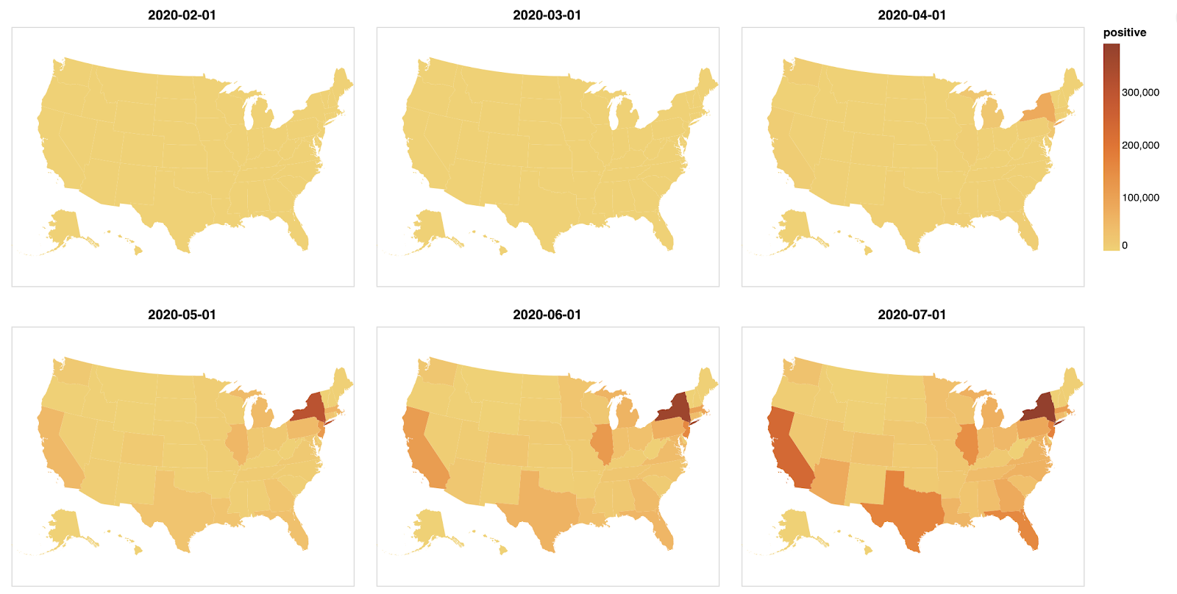
The first set captures the time series by purely using the number of positive confirmed cases .
As we can see clearly, the pandemic started in January/February time and the US was not affected much even in the beginning of March. Things started going downhill for the US from April, and we can clearly see NY heading the way, with Illinois, California, Michigan, Massachusetts, Texas and Florida starting to increase from May and continuing the trend till todate.

Slide 20
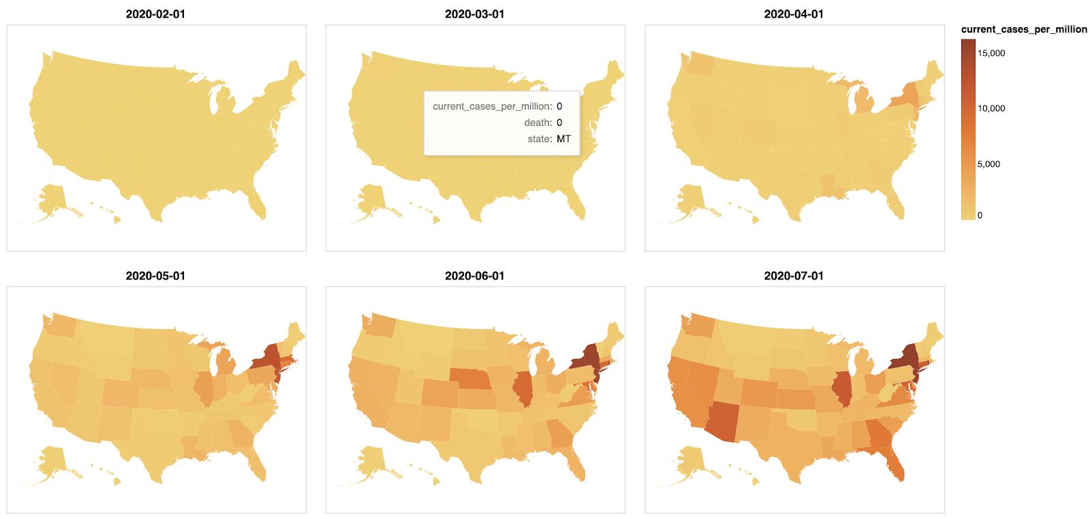
Looking at the confirmed positive cases does not give an overall picture, as we have to take into account the number of recovered cases as well and additionally consider the population density of a region.
Otherwise, larger states with higher populations will always show bigger numbers naturally. By normalizing the data per million we get the following time series charts that depict a more accurate picture of the spread
With the normalized data per million population shown, we can clearly see that the midwest states also show up as being worsley affected starting from May and continuing the trend till date.
Photo credit here

Slide 21
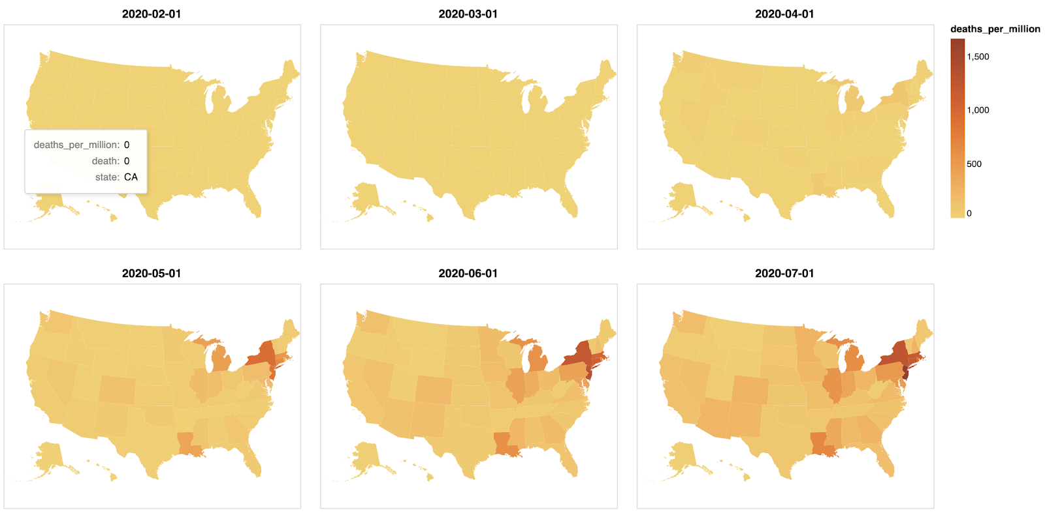
Since the above visualization only shows the number of cases, we have our last set in this series shown in Figure 15, that visualizes the number of deaths. The trend pretty much follows the number of cases, but also differs in where the deaths are concentrated more. One interesting observation is that Louisiana does not seem to have a very large number of cases, but has a high death rate. Another observation is that California has a relatively large number of cases, but seems to have a controlled death rate. NY and NJ appear to dominate both the number of cases and deaths.
Photo credit here

Slide 22
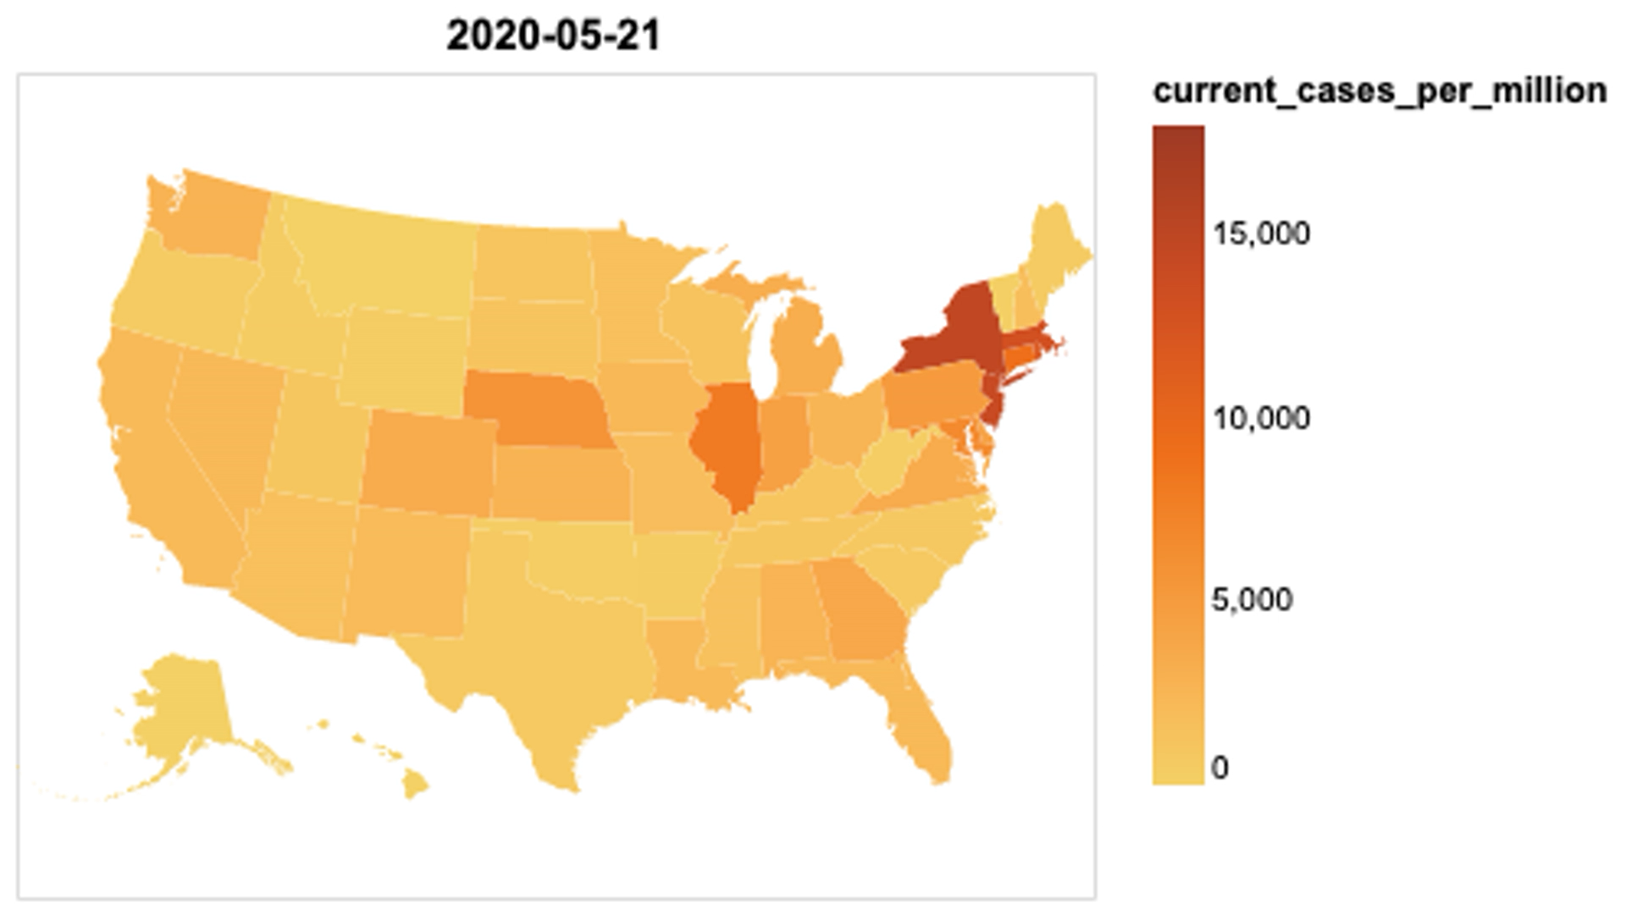
Since our ultimate goal is to create a timelapse video of the coronavirus spread, the following is a time lapse video of the animation.
As we observe the time lapse video of the choropleth maps, we can still see the evolution of the spread of the disease over time as the hue changes, but the change is not apparent. One quick observation here is that, the change in the main variable of interest which is the number of current cases is not very clearly portrayed and using choropleths, visualizing either cases or deaths one at a time gives good visualization, but if we need to visualize both, then we need to explore other options

Slide 23
Methods & Results: Noncontiguous Cartogram
The first type of cartogram we explore is a non contiguous cartogram that maintains the shape of the regions, but still emphasizes our variable of interest using distorted topology and object centroids. In these cartograms the features are not connected, but enlarge or shrink based on the variable of interest. The first set captures the time series by purely using the number of positive confirmed cases .

Slide 24
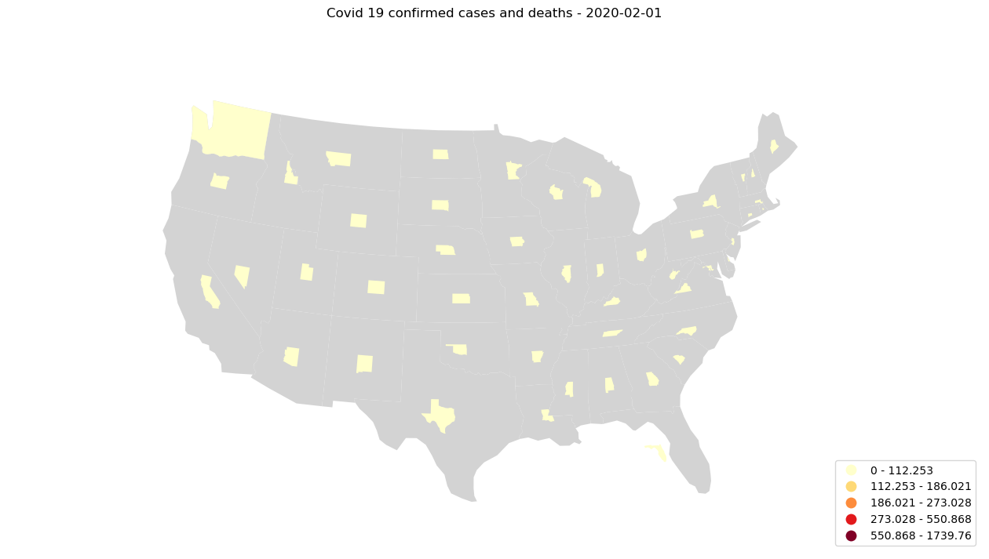

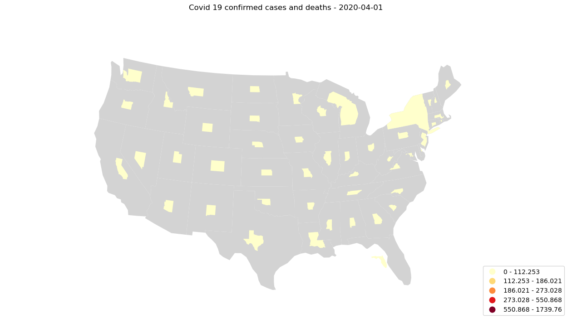
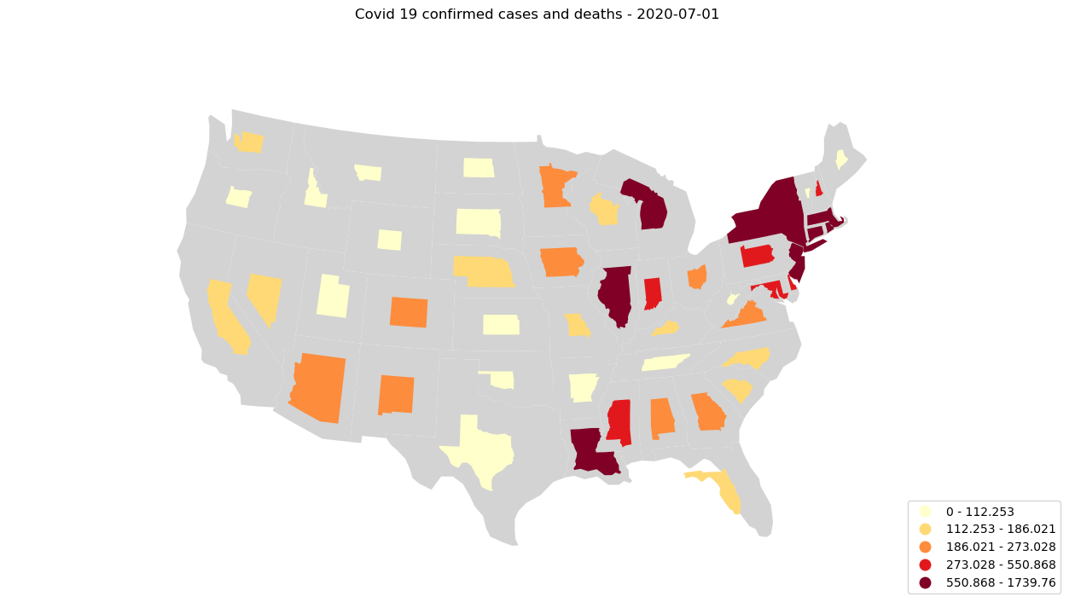
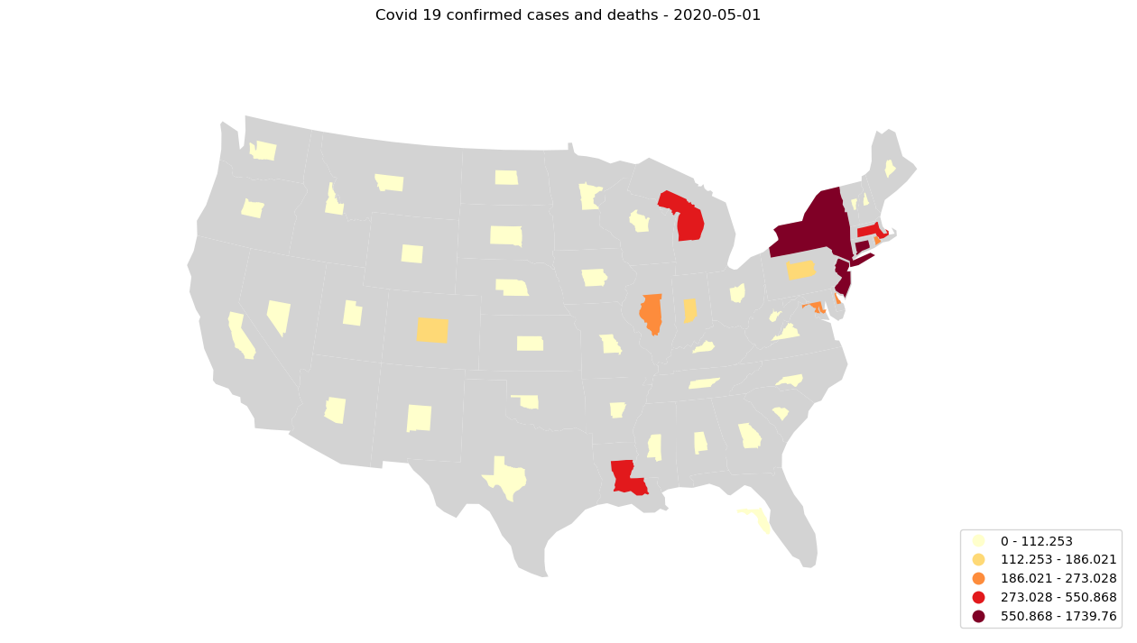
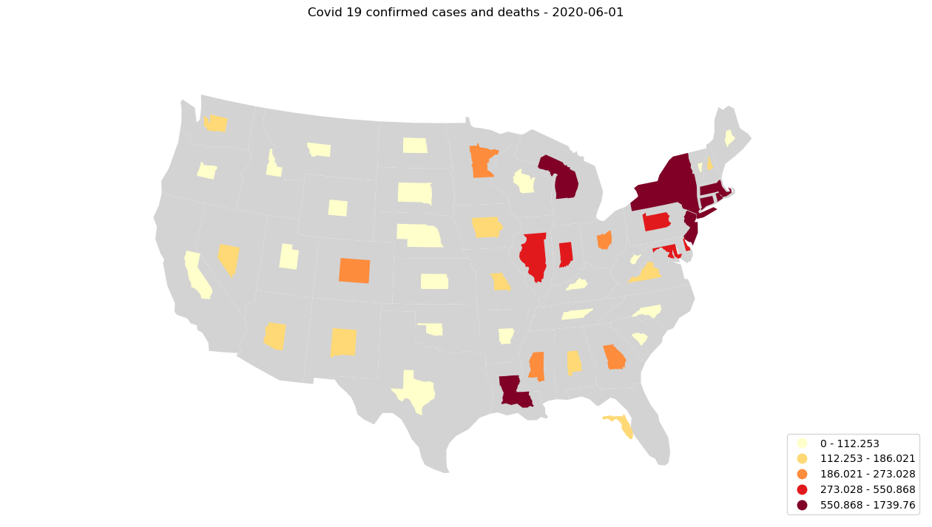
The cartogram gives us a ton of visual insights not immediately obvious in the choropleth maps. The fact that Washington state was the origin of the pandemic in the US, is so clearly visible in the cartogram visualization. Also since the number of cases is represented by the size of the region, we can see Washington state shrink back starting from April as other regions begin to grow. The biggest strength of the visualization is its ability to portray the evolution of both the number of cases and the deaths effectively.
Photo caption can be entered here to the desired length. Tell people about the historical significance of the image or point out relevant pieces of information.
Photo credit here

Slide 25

Lets take a look at the time lapsed video.
The main drawback of this visualization, especially in the context of a time lapse video, is its non contiguous nature, which hinders the smooth flow of frames to some extent.
But still, I would say this is a pretty neat time lapsed video with the ability to portray both the cases and deaths evolution in a nice time series.
The way the states change size and colors is amazing to watch.

Slide 26
Methods & Results: Contiguous Cartogram univariate
A contiguous cartogram preserves the topology of the underlying regions at the cost of distorting the shape. We use a diffusion based density equalizing cartogram technique based on the cartogram program written by Michael Gastner
To make the software package work and produce the necessary changes we made 2 contributions to open source C repo

Slide 27
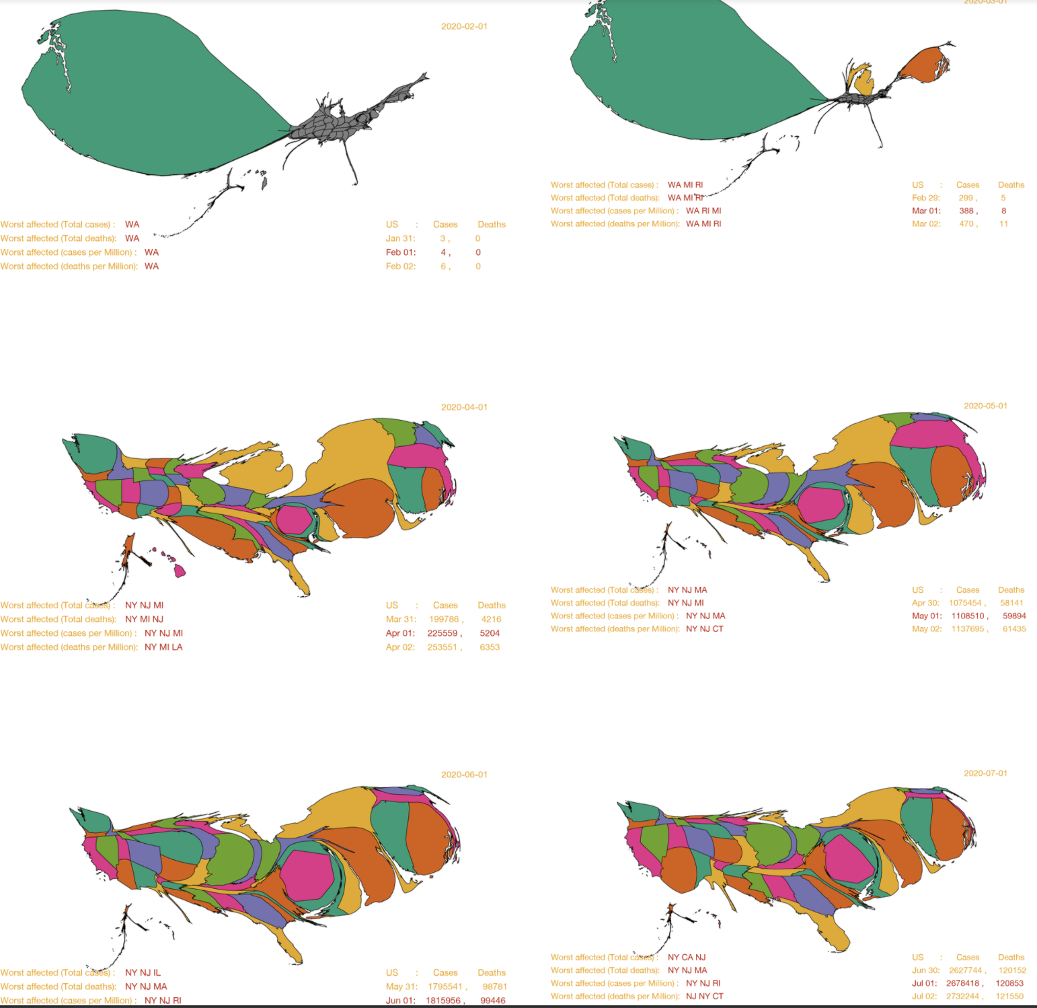
The time series represents the number of current cases using the size of the regions and the color is used to distinguish the different states of the US.
The result is a stunning display of how contiguous cartogram distorts the shape of the underlying region but effectively accentuates the underlying variable it represents, in this instance the number of current cases
Even by early March, Washington, Michigan and Rhode Island register a few cases as the total number of cases in the US is below 400. The cartogram very clearly depicts this so nicely by dedicating the entire land region of US to draw these states with positive cases.
But as the time series progresses, we can observe that by the beginning of April, the pandemic has spread to all the states of the US, the cartogram depicts this perfectly as the land region of the US is distributed across all the states, in proportion to the number of cases they have per Million.
It is also obvious that Washington has its cases well under control by this time, as it is no more in the top 3 worst affected states.

Slide 28
Methods & Results: Contiguous Cartogram univariate IMMEDIDATELY CLICK NEXT PAGE

Slide 29
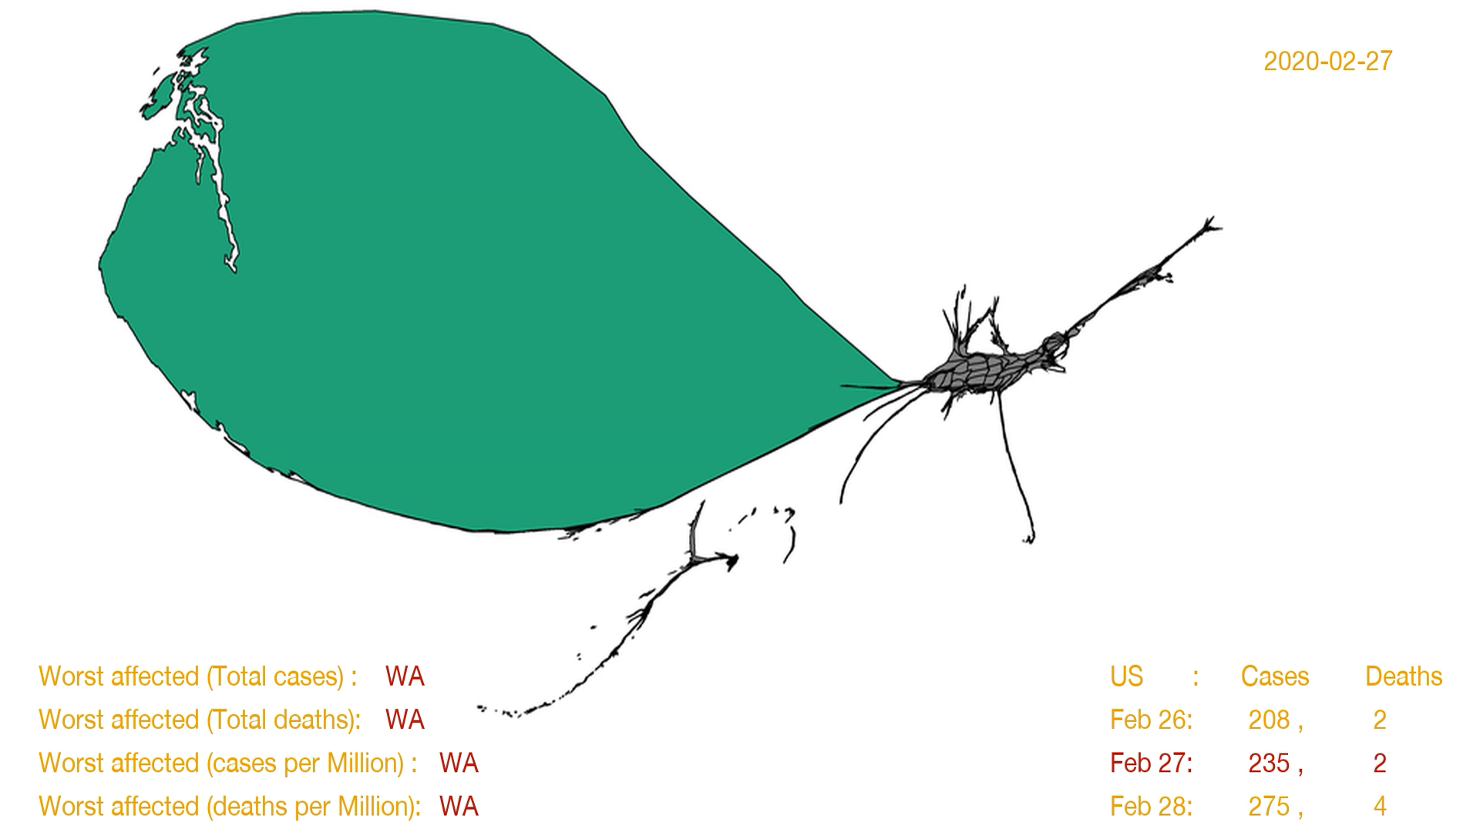
Let us take a look at the time lapse video for this series.
The trend observed from April to May, is that the number of cases have quadrupled, as the more and more states that were a late entry into the picture start having more cases.
Also, the April and May cartograms clearly show how the east and southern parts of the US are prominently becoming the major source of rapid spread of the virus, as the western region seems to have a more controlled spread and a smaller proportion of the cases. This is even more evident in May with the Midwest also becoming more prominent along with the eastern and southern states occupying the bulk share of the cases as depicted by the cartogram.
From May to June, we see that the number of cases have doubled, but the shape of the states of the map almost follow a similar pattern indicating that the cases are rising in a similar manner in June as in May. From June to July, we see that California, Arizona, Florida and Texas seem to balloon up in their cases as depicted in the cartogram and this coincides with the initial phases of the opening up of the different states to parts of their economies.

Slide 30
Methods & Results: Contiguous Cartogram bivariate
The final idea in our visualization series, is to use both the number of cases and the number of deaths using a contiguous cartogram technique. In these set of visualizations, everything remains the same with respect to the previous set of visualizations, except the color scheme. Instead of assigning fixed colors to each state, now the color is assigned based on the number of deaths per million.

Slide 31
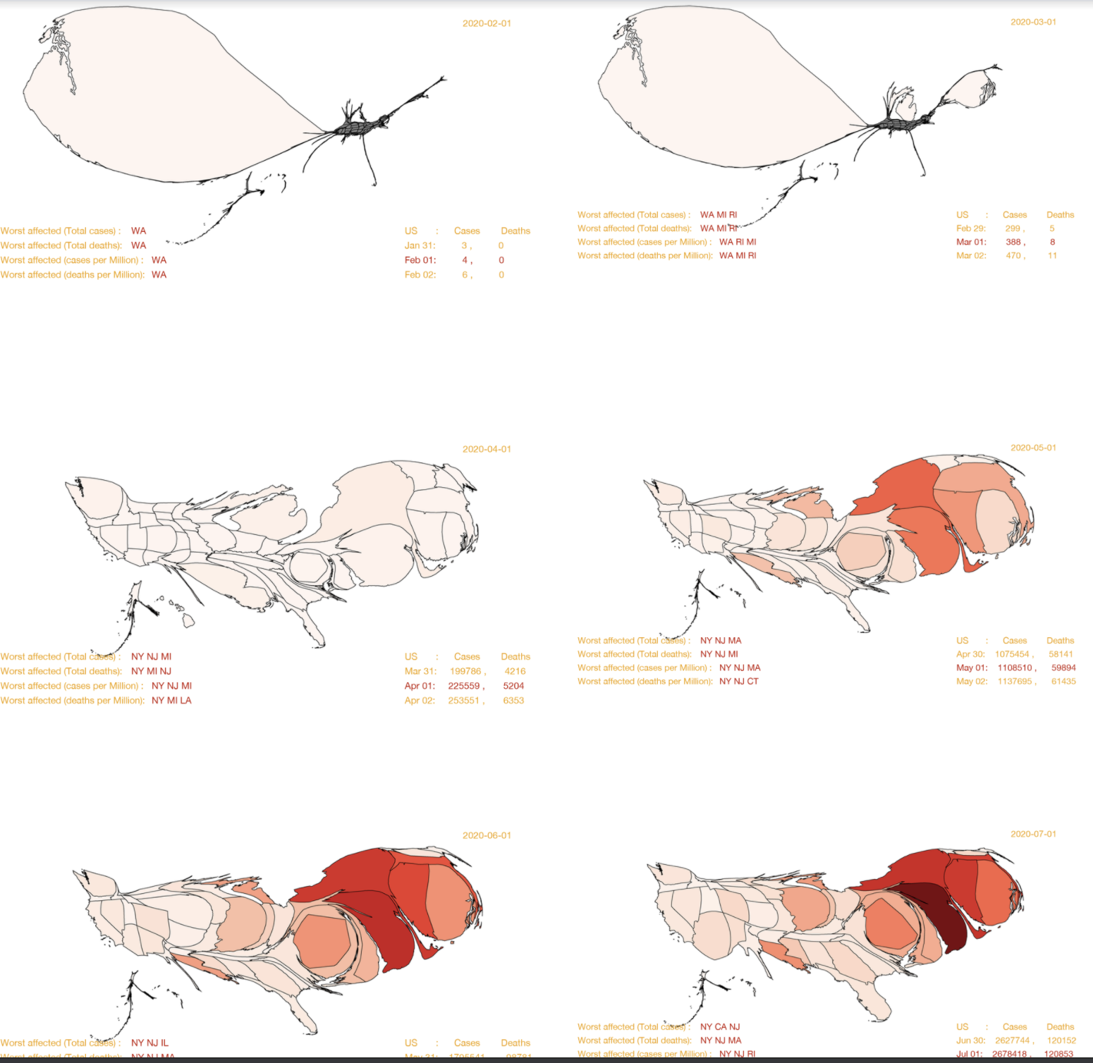
The story depicted in these visualizations holds exactly similar to the previous one, but in addition we get new insights related to the number of deaths.
As the cartograms show, until the beginning of April, the total number of deaths across the US is relatively low, in the order of few hundreds.
But by the time April arrives, the number of deaths increase closer to 5k, spread all over the country, as visible in the light red hue spread across the country. The big increase in the number of deaths happens in April as we see in the transition from April to May, we can observe NY, NJ and CT becoming darker and the deaths have ballooned up by 10x.
As observed in the total number of cases, the East once again dominates the map with respect to the number of deaths per million. The cartograms also depict the rise of New Jersey in dominating the number of deaths in the last 3 months.

Slide 32
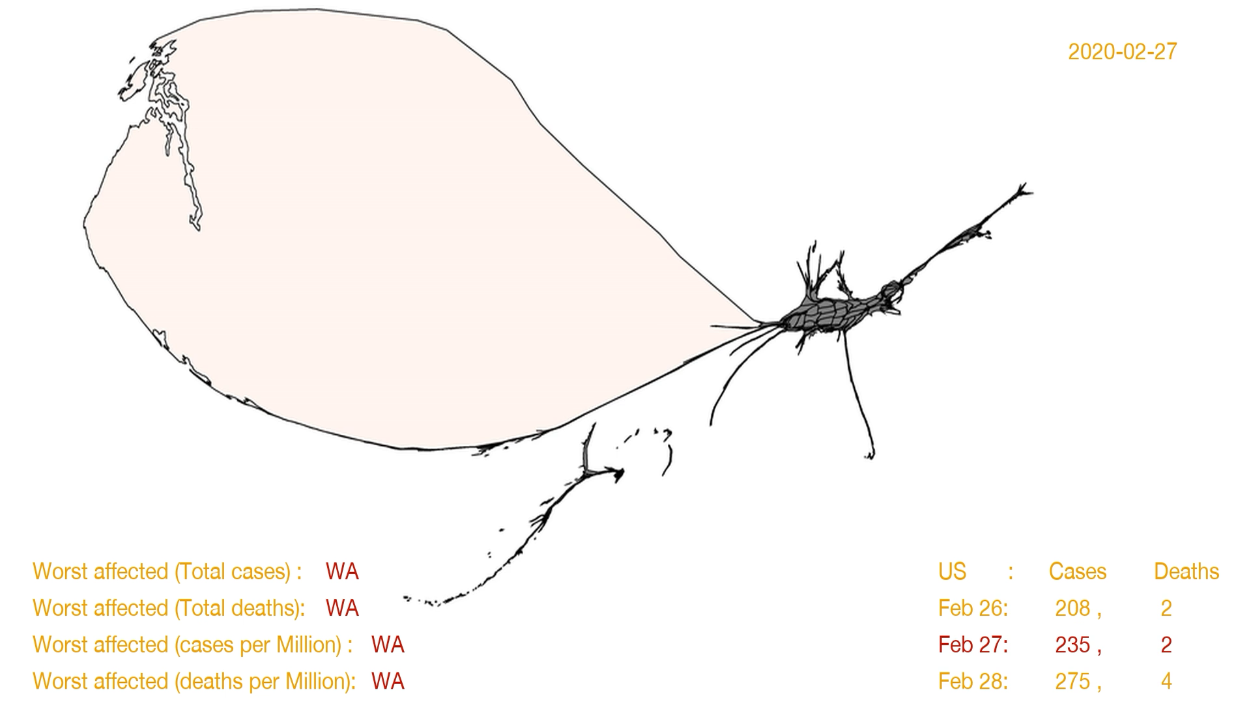

Slide 33
Conclusion and Future Work

Slide 34
Conclusion and Future Work
We started this journey of creating a geo time series of visualizations relating to the spread of the coronavirus to ultimately end with a goal of producing a nice animation using a time lapsed video.
The initial experiments were done using choropleth maps, and though producing stunning visuals, the choropleth approach had two main misgivings, one to do with displaying cases and deaths simultaneously and the other to do with the natural flow of the time lapse video.
We moved on to using noncontiguous cartograms, producing time series visualizations and time lapsed video capturing both the number of cases and deaths of the coronavirus spread, suffering from the only drawback that the noncontiguous nature could be improved to be more suitable for the time lapsed animation.
Our next approach resulted in using density equalizing cartograms with the first series focusing only on the number of cases and producing a stunning set of visualizations and time lapsed animation, and we moved on to improve this approach by using sequential colors to represent the deaths as well, thereby resulting in visuals and time lapsed video neatly portraying the cases and deaths.
The one major drawback of the cartogram approaches is the resulting distortion in shape, which makes it harder to identify individual regions clearly without the viewer having to put in some effort to create a mental image of the original map or by constantly referring back to the non distorted version.

Slide 35
Conclusion and Future Work
One experiment that failed in our approach, was trying to find the intermediate frames given two frames at t1 and t2. The idea behind this, is to get a much more smoother visualization by using linear interpolation and we tried using the Image.blend function from the PIL library did not work for our images as we could see the shadow of the images in the in-between frames and we need to find a better way of doing the linear interpolation using the Geo Json data directly and by using the svg format of the images.
Also, more work can be done in the underlying cartogram program itself to display the state names in the visuals to make it easy on the viewers to identify the regions. So far, this has not been done in the available noncontiguous and contiguous cartogram libraries and this will be an interesting undertaking for the future.

Slide 36
Thank You Professor and the Tas for their guidance in the project

